Slide 1


Performance Testing
Nahla Mosaad Ali
Presented By Gehad Khaled Sayed
Khaled Hamdy Zaki
Supervised By : Eng. Amany Shousha

Slide 2

Table of Contents
What is Performance Testing?
Why Performance Testing?
Types of Performance Testing
Performance Testing Process
Common Performance Problems
Tools for Performance Testing
What is Jmeter?
Why Jmeter?
Demo(Performance Testing in Jmeter)
Notes:
https://www.simplilearn.com/tutorials/jmeter-tutorial/jmeter-performance-testing

Slide 3
What is Performance Testing?
Performance Testing
is a Software Testing Type used for testing the software application under a specific workload.
Notes:
Performance Testing
is a Software Testing Type used for testing the Speed, Response Time, Stability, Reliability, Scalability and Resource Usage of a software application under a specific workload Speed – Determines whether the application responds quickly
Scalability – Determines maximum user load the software application can handle.
Stability – Determines if the application is stable under varying loads

Slide 4
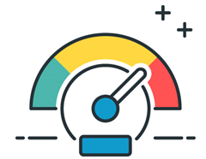
Why Performance Testing?
To ensure your software meets the expected levels of service and provide a positive user experience.
And?
With the right testing tool, we could highlight improvements that we should make relative to speed, stability, and scalability before they go into production.

Slide 5
When is recommended?
•Application with concurrent users
•Response Time is Critical
•Shared infrastructures /Components
•New Version or Releases
•Before Campaigns

Slide 6
Types of Performance Testing
Endurance (SOAK) Testing
Volume Testing
Load Testing
Stress Testing
Spike Testing
Scalability Testing
Notes:
https://qualitestgroup.com/insights/blog/demystifying-the-six-major-types-of-performance-testing/
•Stress Testing
Put an extreme load on the system until it breaks
This test pushes an application beyond normal load conditions to determine which components fail first. Stress testing attempts to find the breaking point of the application and is used to evaluate the robustness of the application’s data processing capabilities and response to high volumes of traffic.
Yt3ml b tre2ten... momkn azwd 3dd el users awy msln w a22ll el w2t ( 1000 , 2) w ashof hyst7ml wala la w hys7tm kam.. Aw bl stepping thred.
Load Testing
The purpose of load testing is to evaluate the application’s performance under increasingly high numbers of users. Load, or increasing numbers of users are applied to the application under https://qualitestgroup.com/initiatives/load-and-performance-testing-services/test and the results are measured to validate the requirements are met. This load can be the expected concurrent number of users on the application performing a specific number of transactions within the set duration. This test will give out the response times of all the important business critical transactions. If the database, application server, etc. are also monitored, then this simple test can itself point towards bottlenecks in the application software.

Slide 7
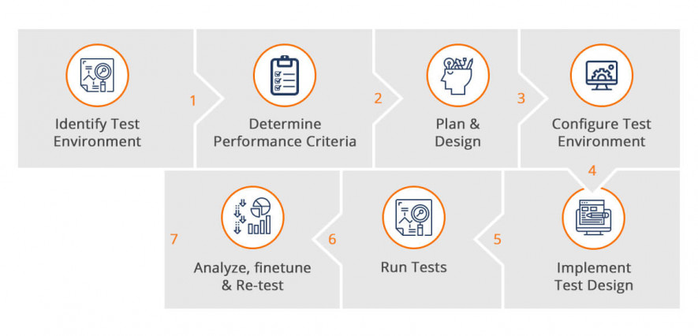
Performance Testing Process
The goal of performance testing isn’t to find bugs, but rather to identify and eliminate performance bottlenecks.
The testing process checks both stability and scalability with a goal of preventing your company from releasing software updates that cause applications to run slow.
Below is a generic process on how to perform performance testing :

Slide 8
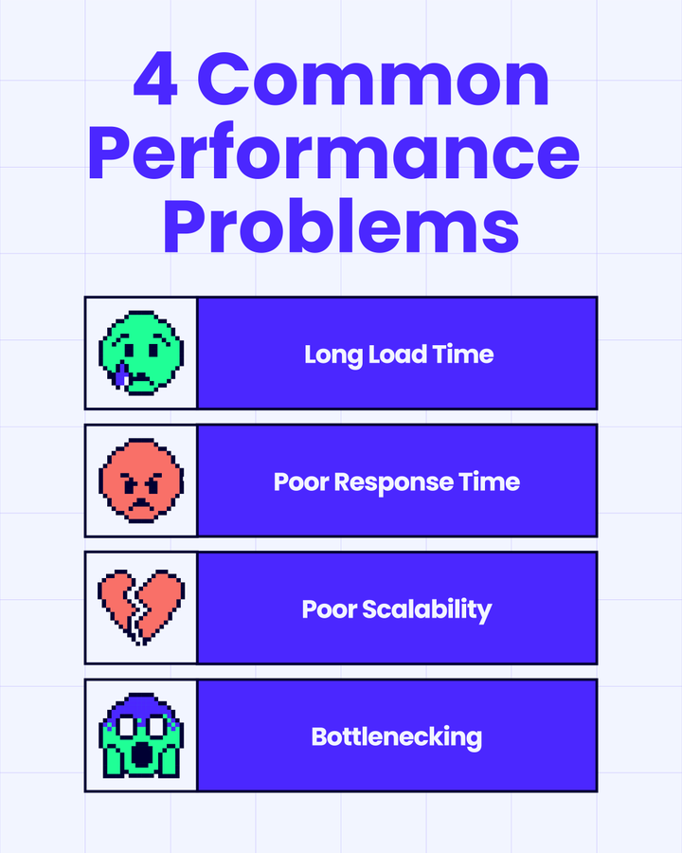
Common Performance Problems
Most performance problems revolve around speed, response time, load time and poor scalability. Speed is often one of the most important attributes of an application. A slow running application will lose potential users. Performance testing is done to make sure an app runs fast enough to keep a user’s attention and interest.
common performance bottlenecks are :
CPU utilization
Memory utilization
Network utilization
Operating System limitations
Disk usage

Slide 9





Tools for Performance Testing

Slide 10
What is JMeter?
Apache JMeter is a java open-source software tool, that is used as a Load Testing tool for analyzing and measuring the Performance of a variety of services

Slide 11
Why JMeter?
User Friendly
Documentation
Reporting
Support
Open-Source
Recording
Data extraction
Notes:
Data extraction in popular response formats, such as JSON, XML, HTML, etc
Test recording for native applications and browsers
Excellent support community
It offers users various capabilities for performance testing and integration.
users of the tool can easily customize and develop features within the existing framework.
Cons
Memory consumption for the application can be high when used in GUI mode
After a certain limit, high memory consumption causes errors for a large number of users
Can be difficult to test complex applications using JavaScript

Slide 12

JMeter Components
A Test Plan:
Can be viewed as a container for running tests.
It defines what to test and how to go about it.
Test Plan comprises of at least one Thread Group.
Thread groups: Consist of one or more
Logic controllers.
Sampler.
Generating controllers.
Listeners.
Timers.
Assertions.
Configuration elements.
Notes:
the thread group elements control the number of threads JMeter will use during the test.
Logic controllers: order of processing of Samplers in a Thread. Logic controllers can change the order of a request coming from any of their child elements. Some examples are − For Controller, While Controller, Loop Controller, IF Controller,
Sampler: Samplers allow JMeter to send specific types of requests to a serve
Generating controllers
Listeners: let you view the results of Samplers in the form of tables, graphs, trees, or simple text in some log files
Timers: You can add a timer element which allows you to define a period to wait between each request.
Assertions: include some validation test on the response of your request made using a Sampler.
Configuration elements: Configuration Elements allow you to create defaults and variables to be used by Samplers.

Slide 13

Finally, Let’s see our Demo Project

Slide 14

Thank you!

Slide 15

References
https://www.neotys.com/insights/performance-testing
https://stackify.com/ultimate-guide-performance-testing
https://www.guru99.com/performance-testing.html#5
Notes:
https://www.youtube.com/watch?v=tTgyrSWlj5s&ab_channel=edureka%21
https://www.youtube.com/watch?v=tTgyrSWlj5s
https://www.youtube.com/watch?v=mXGcBvWYl-U&ab_channel=edureka%21

